Slide 1
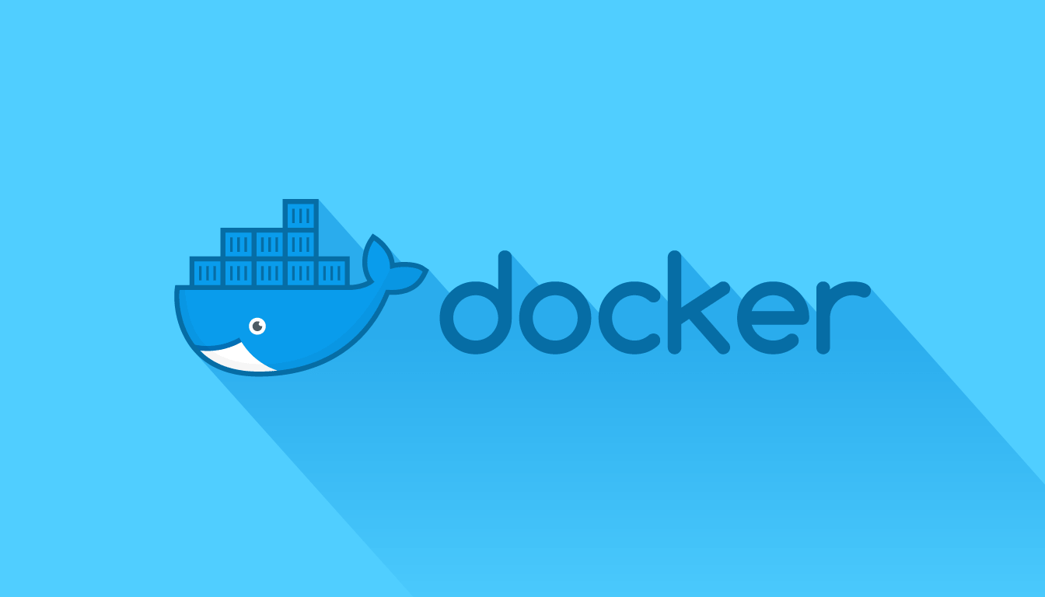

Slide 2
Agenda
Why Docker?
The Problem to Solve (Traditional Deployment)
Solution with Virtual Machines
Solution with Docker Containers
What is Docker?
Docker Advantages
Docker Engine
Docker Architecture
Docker Objects
Docker Hub
What is Kubernetes?
Kubernetes Components
JAVA TRAINING www.busyqa.com/bigdata |www.busyqa.com/online-automation

Slide 3
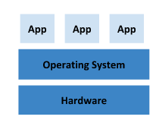
The Problem to Solve
Companies could have hundreds or even thousands of applications.
Applications have to share servers because it is expensive to have a separate server for each application.
Applications have different requirements, for instance:
Some applications run on Linux, others on Windows, etc.
Some use Java 7, others Java 8, etc.
Different library versions.
Traditional Deployment

Slide 4
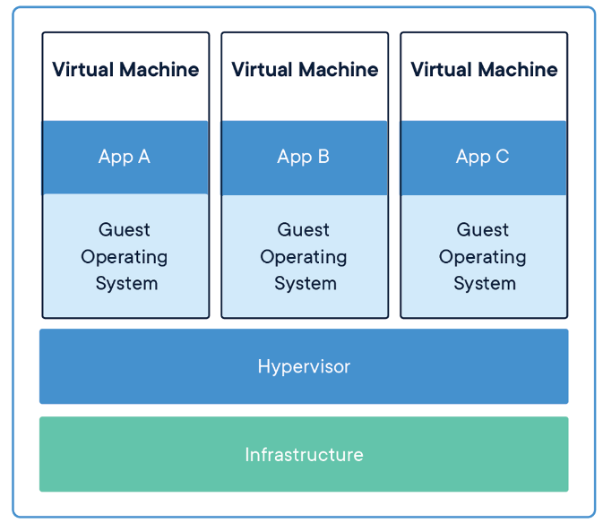
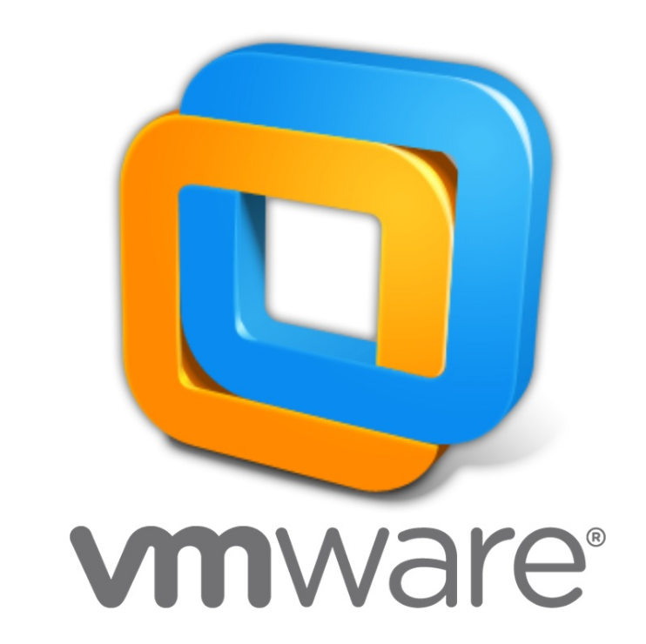
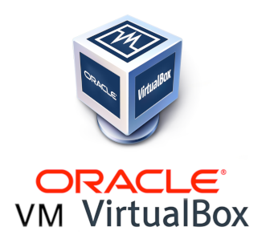
Solution with Virtual Machines
Virtual Machines (VMs) divide the computer’s hardware so that applications run isolated.
VMs are heavy because they run a full-blown operating system so that only a few VMs can run on a computer.

Slide 5
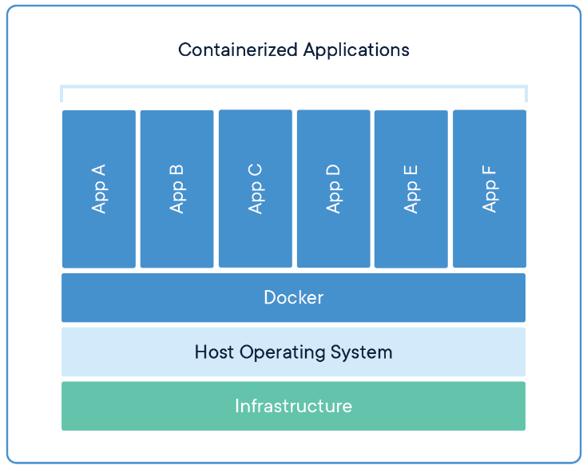
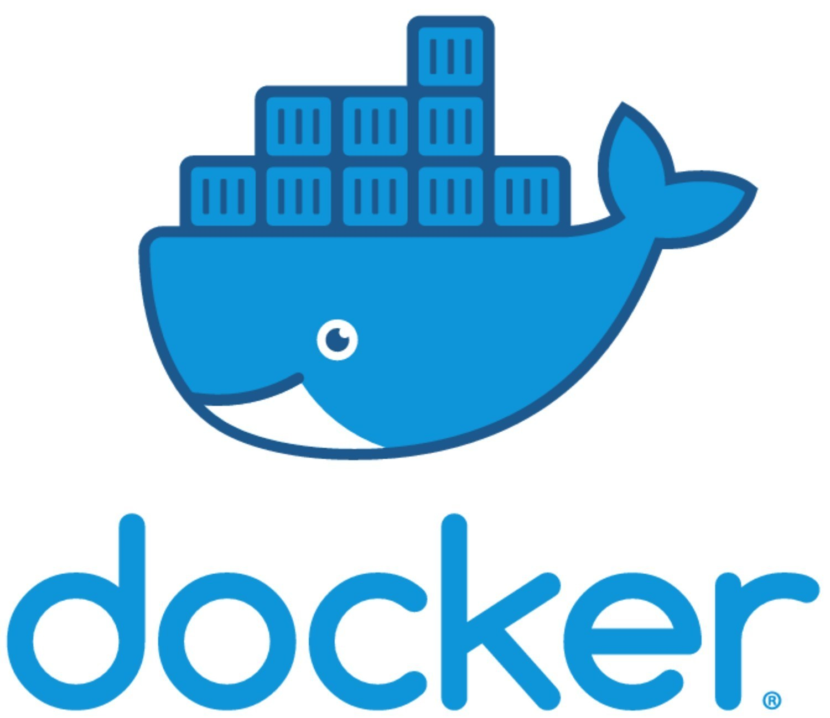
Solution with Docker Containers
Containers are fast and light-weight because they divide the operating system, not the hardware.
Containers run isolated.
One application should run per container only for architectural reasons and to keep things simple.
More containers can run simultaneously than VMs.

Slide 6
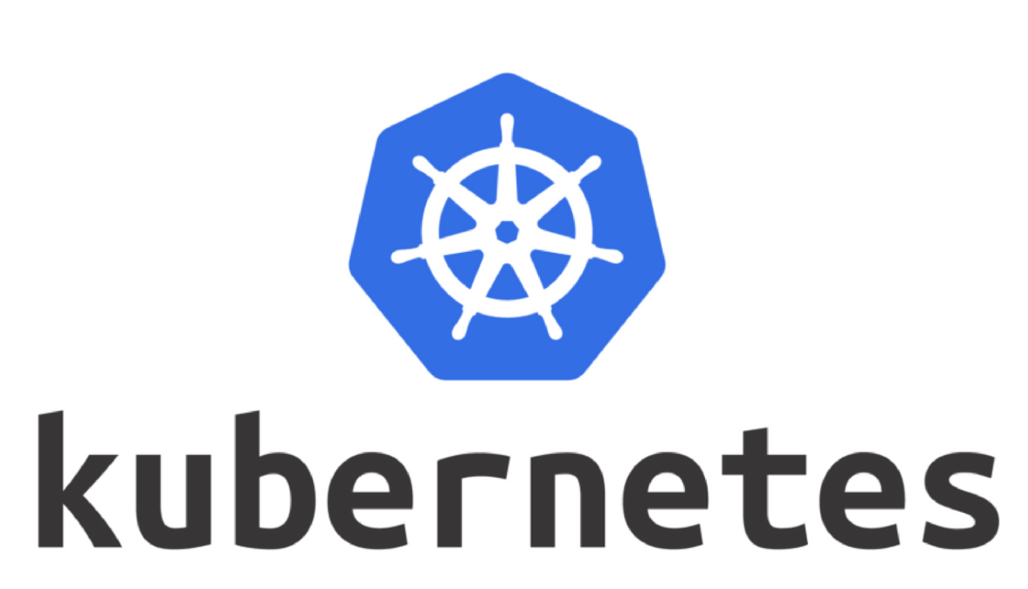
The New Problem
We can have hundreds of containers running on multiple computers.
How do we know if the containers are healthy?
How can we take care of them.
Kubernetes comes to the rescue.
It is an open-source container orchestrator designed by Google that manages the containers automatically.

Slide 7
What is Docker?
It is an open platform that provides the ability to package and run an application in a loosely isolated environment called container.
The isolation and security allow us to run many containers simultaneously on a given host.
It is used for developing, shipping, and running applications.
Develop applications and their supporting components using containers.
The container becomes the unit for distributing and testing applications. Eliminates the “But it works on my machine” problem.
Deploy applications into different environments as a container. No environment configuration required as all the configuration is in the container.
Notes:
There is no need to install an application on our computers as we can run it in a container. E.g. We can run a database in a container.
Docker application:
-- You have two applications, one uses Java 7 and the other uses Java 8.
-- With docker, you don't have to worry about installing Java 7 and Java 8 in your server and make sure your application is using the right version.
-- Instead each application will run within an docker container that has the Java version you need.
-- This way, you no longer have to worry about the Java versions running on your server and the possible version conflicts that may come up.
-- Your applications will run isolated in their respective container using the proper versions of the libraries they need.

Slide 8
Docker Advantages
Fast and consistent delivery of your applications.
Docker streamlines the development lifecycle by allowing developers to work in standardized environments.
Responsive deployment and scaling.
Docker’s container-based platform allows for highly portable workloads as we can deploy the containers on any environment.
Running more workloads on the same hardware
Docker is lightweight and fast.
It provides a viable, cost-effective alternative to hypervisor-based virtual machines.

Slide 9
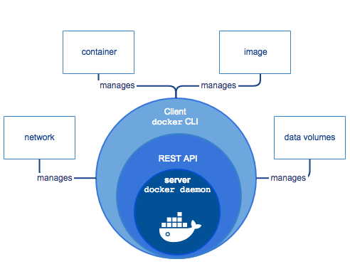
Docker Engine
Docker Engine is a client-server application comprised of:
A server which is a long-running program called a daemon process (the dockerd command). The daemon creates and manages Docker objects such as images, containers, networks, and volumes.
A REST API that programs can use to talk to the daemon and instruct it what to do.
A command line interface (CLI) client (the docker command) to send commands to the daemon via the REST API.
Notes:
‹#›

Slide 10
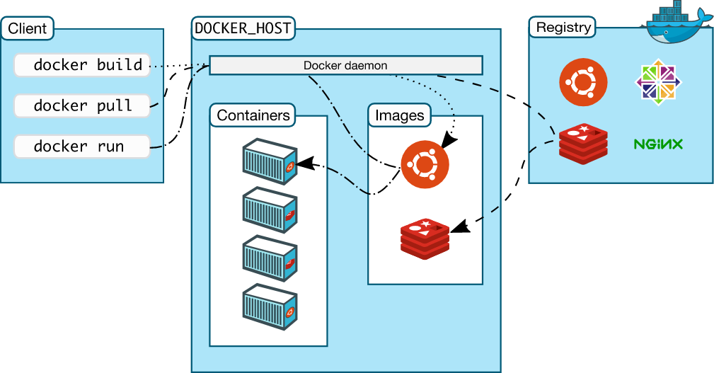
Docker Architecture
Docker uses a client-server architecture. The Docker client talks to the Docker daemon which does the heavy lifting of building, running, and distributing your Docker containers.
The Docker client and daemon can run on the same system, or you can connect a Docker client to a remote Docker daemon.
The Docker client and daemon communicate using a REST API.
Notes:
‹#›

Slide 11
Docker Objects
Images: It is a read-only template with instructions for creating a Docker container.
Container: It is a runnable instance of an image. You can create, start, stop, move, or delete a container using the Docker CLI. When a container is removed, any changes not stored in persistent storage disappear.
Registry: It is repository that stores Docker images. Docker Hub is a public registry that anyone can use. Docker looks for images on Docker Hub by default.
Notes:
https://kubernetes.io/docs/concepts/overview/what-is-kubernetes/

Slide 12
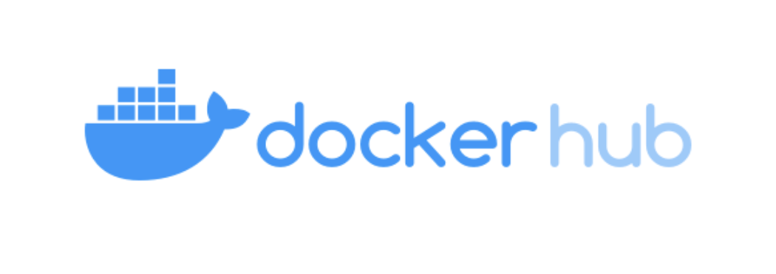
Docker Hub
It is a hosted repository service provided by Docker for finding and sharing container images within teams.
It has an array of content sources including container community developers, open source projects and independent software vendors building and distributing their code in containers.
Notes:
https://kubernetes.io/docs/concepts/overview/what-is-kubernetes/

Slide 13
What is Kubernetes?
It is a popular container orchestrator created by Google.
Considering that we have many servers, a container orchestrator decide how to run those containers workflows across those servers.
In a production environment, you need to manage the containers that run the applications and ensure that there is no downtime. For example, if a container goes down, another container needs to start.
Many Vendors make a distribution of Kubernetes. Similar to the concept of linux distributions. Each distribution package up a set of tools.
Notes:
https://kubernetes.io/docs/concepts/overview/what-is-kubernetes/

Slide 14
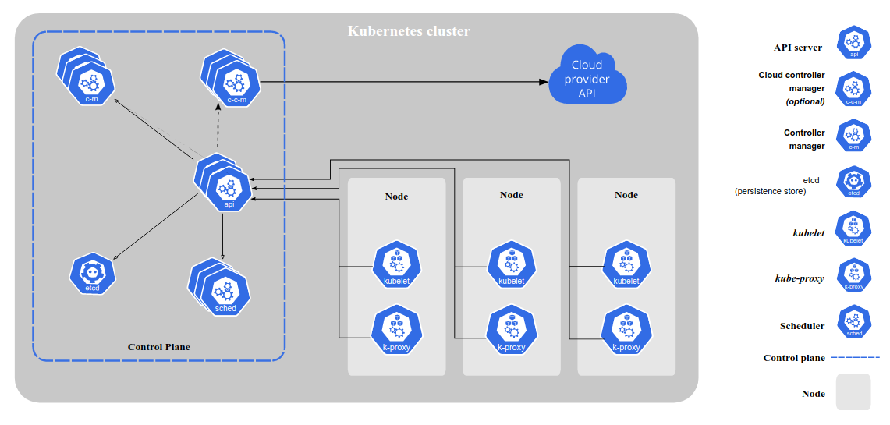
Kubernetes Components
Notes:
https://kubernetes.io/docs/concepts/overview/components/

Slide 15
Coop Onboarding Video
https://www.youtube.com/watch?v=ncNjIz2KE-s
Notes:
Salary.- Min 4.18

Slide 16

Any Questions

